Slide 1
ONLINE STUDY NOTES PORTAL

Slide 2


Agenda
A
1)Abstract
2)Project Requirements
3)Features and highlights
4)Technical aspects
5)Challenges faced during development
6)Screenshots
7)Future enhancements
8)Conclusion
9)References

Slide 3
ABSTRACT
This abstract introduces an online study notes portal that offers a wide range of resources for learners. The portal serves as a centralized platform where users can access free notes contributed by educators and students, covering diverse subjects and academic disciplines. Additionally, the portal provides a selection of online courses, both free and paid, designed by experienced instructors. The platform aims to provide a comprehensive learning experience by combining free study materials with the opportunity to enroll in courses to enhance knowledge and acquire new skills..

Slide 4
Project requirements
Add/Edit file:-User can add, edit, upload and delete files
Edit profile:- User can edit their profile details
Add to favorites:-User can add searched files to their favorite list
Search :-User can search files which are required for them
Notifications:-Notifications for user login , crud operations,
Rating:-user can rate the courses after enrollment
Payment:-user can enroll for paid courses by doing online payment
Add/Edit course:-Admin can add, edit, upload and delete courses
Add/edit tags:- Admin can add, edit the tags for courses
Add/edit prerequisites:- Admin can add, edit the tags for courses

Slide 5
Features and Highlights
Add to favorites:-User can add searched files to their favorite list
Search :-User can search files which are required for them
Notifications:-Notifications of other users posting documents
Rating:-user can rate the courses after they have completed the course based on its proficiency
Payment:-user can enroll for paid courses by doing online payment
Certificate generator:-After course completion user can get the certificate

Slide 6
TECHNICAL ASPECTS
“
”

Slide 7




Python
SQLite
Jazzmin
VS Code
general-purpose
interpreted
interactive
object- oriented scripting language
high-level programming language
SQL database engine
high-reliability
free to use
Jazz up Admin Site
Responsive
Customisable UI
versatile source code editor
cross-platform, available for Windows, macOS, and Linux

Slide 8
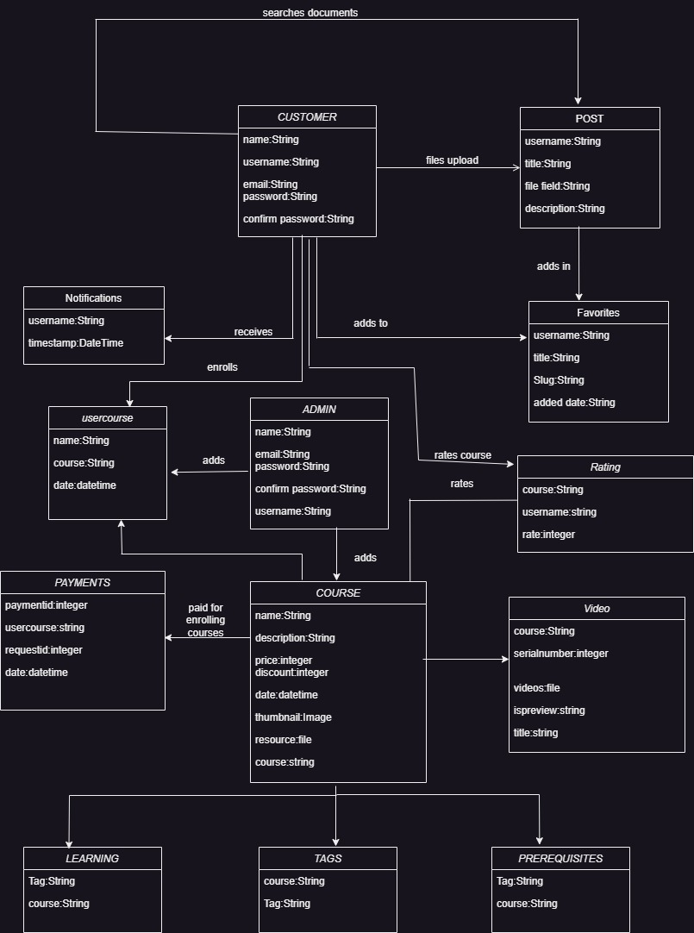
Class Diagram

Slide 9
Challenges faced during the development
USER-SPECIFIC PERMISSION AND ACCESS CONTROL
USER AUTHENTICATION
CRUD OPERATIONS
User authentication in an online study notes portal involves implementing secure login mechanisms (such as username/password or two-factor authentication) to verify the identity of users, allowing only authorized individuals to access and interact with their study notes, ensuring data confidentiality and protection.
Implementing user-specific permission and access control in an online study notes portal involves defining roles (such as user, and admin) and assigning appropriate privileges, ensuring that users can access and modify notes based on their assigned roles, thus maintaining data security and privacy.
Crud operations:-I have faced validation errors while performing crud operation so I used forms.py for crud operation .Forms.py automatically handles validations of the fields.

Slide 10
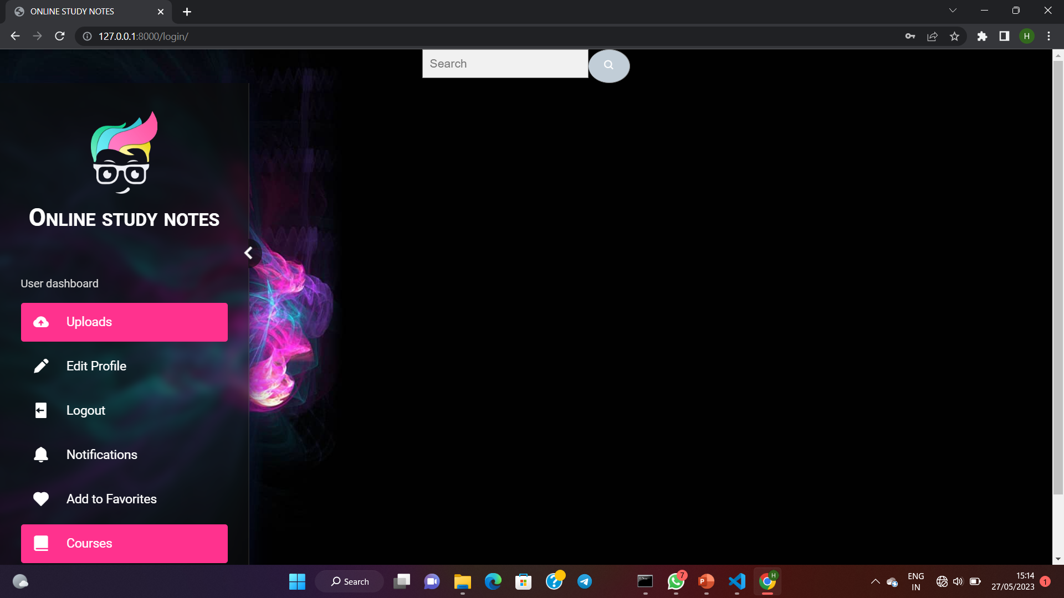
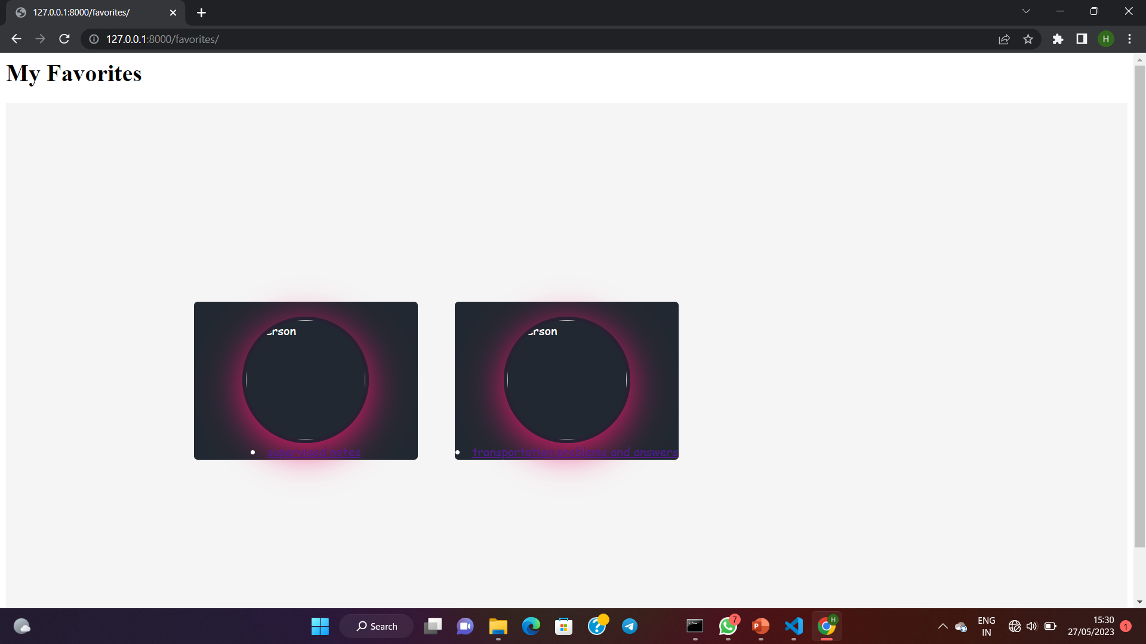
SCREENSHOTS
User Dashboard
Interface After User Login
Can navigate to different options such as uploads, add to favourites etc..
ADD TO FAVORITES
Posts we have searched cab be added to favourites for future use
We can download the posts as well

Slide 11
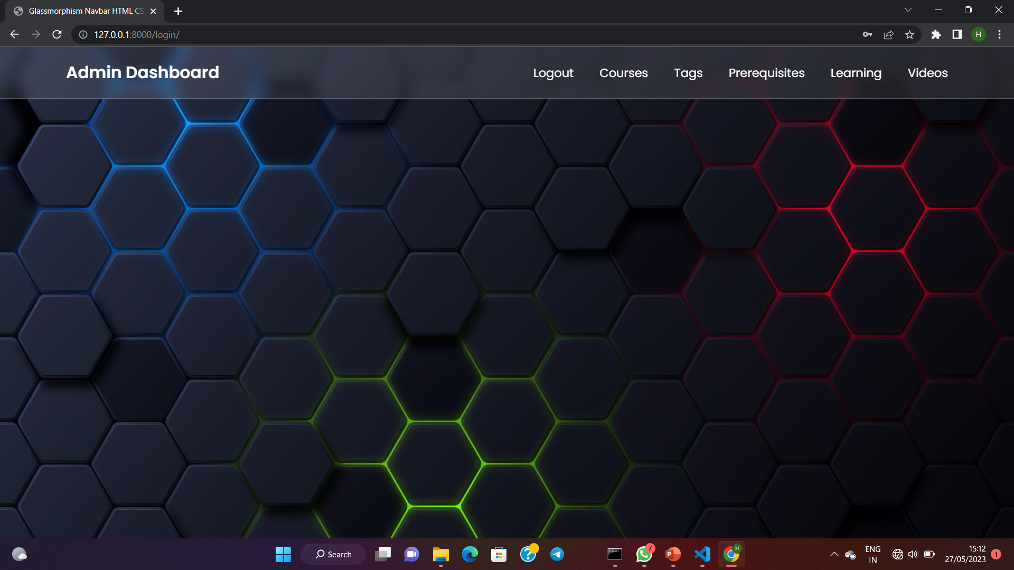
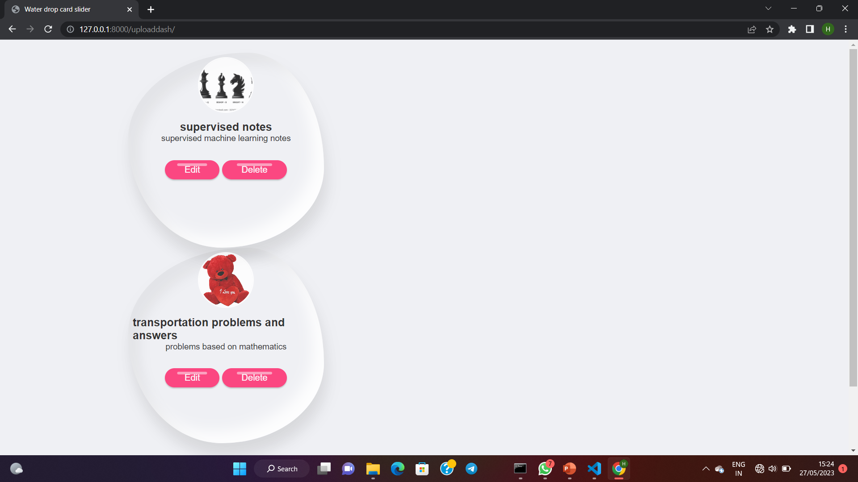
Admin Dashboard
Admin Interface After Login
Can navigate to different options such as logout, courses, tags, videos etc..
UPLOAD INTERFACE
Displays Documents uploaded by the user
Can take action such as edit and delete

Slide 12
FUTURE ENHANCEMENTS
1)RECENT DOCUMENTS :-The system should track and store information about recently accessed or modified documents
2)VIDEO CHAT:- Users who are using online study notes portal can chat with experts by video call for clearing their doubts with experts.
3)ONLINE DEGREE COURSES:-To collaborate with universities to provide online degree courses at affordable price
4)QUESTION AND ANSWER DISCUSSING COMMUNITY:-In this users can discuss their doubts as a question or uploading the document/s to the group to get answers.
5) QUIZ:-In this quiz are provided in each course based on the video lessons of each course.
6) CERTIFICATE GENERATOR:-After completion of quiz provided in the course user can get the certificate .

Slide 13
CONCLUSION
In conclusion, an online study materials portal that offers free notes and online courses has the potential to revolutionize the way individuals access educational resources. By providing a vast collection of study notes, personalized learning experiences, and interactive tools, such a portal can empower learners to acquire knowledge and enhance their skills. The challenges faced during development, ranging from content management to scalability, can be overcome through careful planning and continuous improvement. With future enhancements like enhanced personalization, interactive learning tools, and integration of emerging technologies, the online study materials portal can continue to evolve and provide an engaging and accessible learning platform for users worldwide. Overall, the online study materials portal holds tremendous promise in making education more accessible and fostering lifelong learning.

Slide 14
REFERENCES
1)CHATGPT
2)STACK OVERFLOW
3) https://dev.to/madhubankhatri/file-share-website-updated-version-django-project--1akp
4) https://studygyaan.com/django/django-crud-create-retrieve-update-delete-function-based-views?ez_vid=057433bf2d2159c8bbffbfba9f36d35506722b432a927934e289e372eeb9a0f9#ezoic-pub-video-placeholder-3998

Slide 15
Thank you
HEMA PRABHA M

